Slide 1
Random-Number Generation

Slide 2
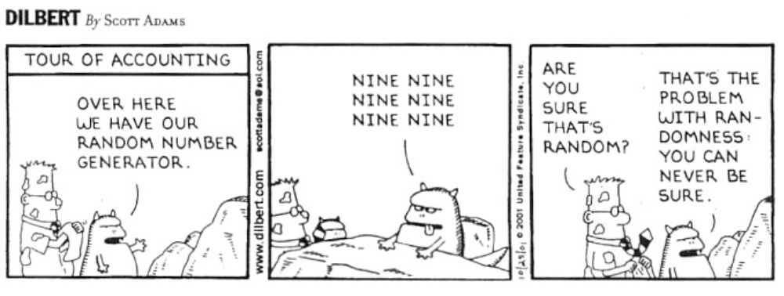

Slide 3
Random-Number
As the term suggests, a random number is a number chosen by chance -- i.e., randomly, from a set of numbers.
All the numbers in a specified distribution have equal probability of being chosen randomly.
For a number in a sequence or distribution to be truly random, it must be independent.
The independence of numbers means there is no correlation between successive numbers.

Slide 4
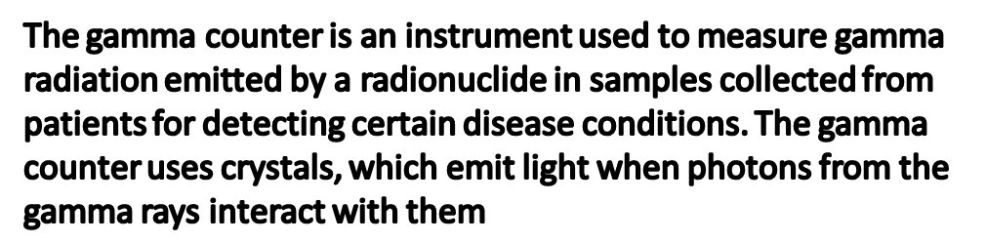
Historically
Throw dices
Deal out cards
Draw numbered balls
Use digits of π
Mechanical devices (spinning disc, etc.)
Electric circuits
Electronic Random Number Indicator (ERNIE)
Counting gamma rays
In combination with a computer
  Hook up an electronic device to the computer
  Read-in a table of random numbers

Slide 5
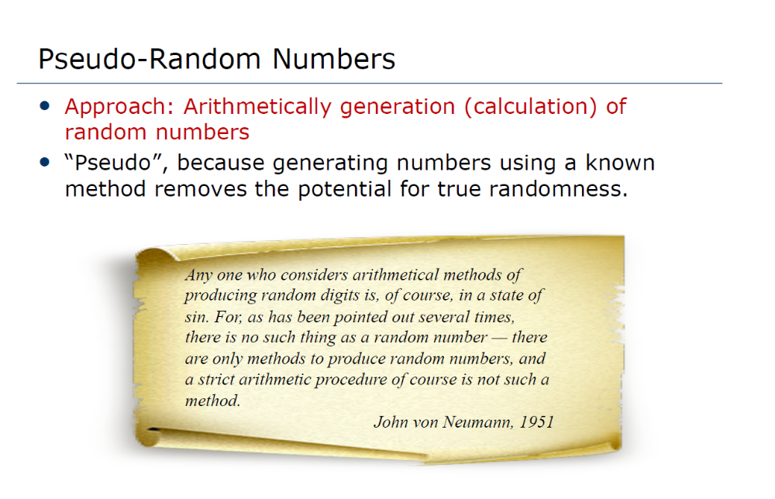

Slide 6
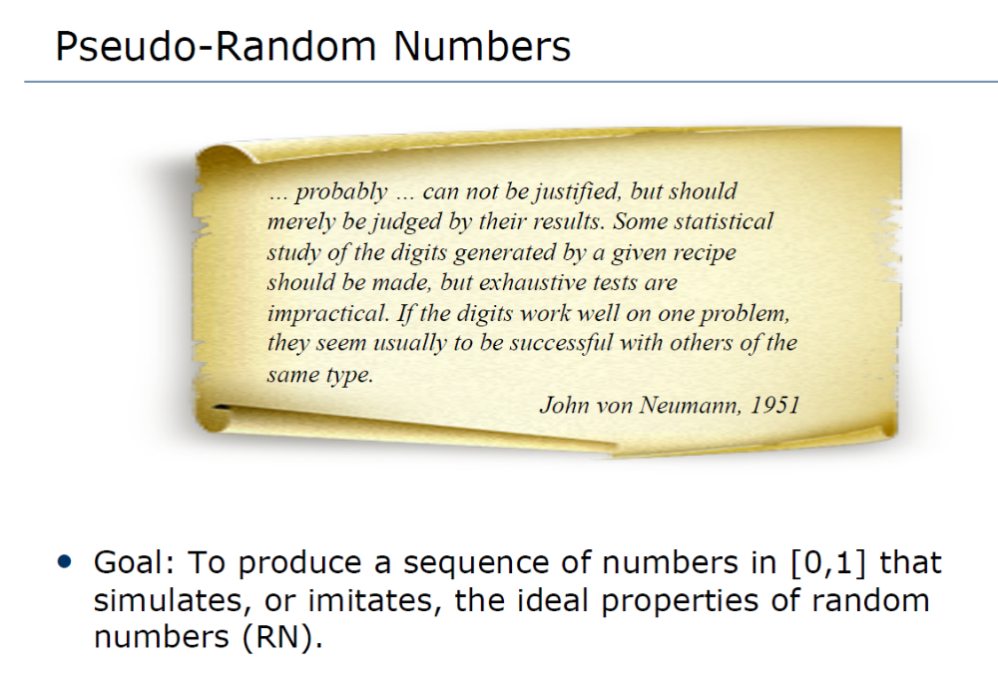

Slide 7
Pseudo-Random Numbers
Important properties of good random number routines:
Fast
Portable to different computers
Have sufficiently long cycle
Replicable
Verification and debugging
Use identical stream of random numbers for different systems
Closely approximate the ideal statistical properties of uniformity and independence

Slide 8
Pseudo-Random Numbers
Problems when generating pseudo-random numbers
The generated numbers might not be uniformly distributed
The generated numbers might be discrete-valued instead of continuous-valued
The mean of the generated numbers might be too high or too low
The variance of the generated numbers might be too high or too low
There might be dependence:
Autocorrelation between numbers
Numbers successively higher or lower than adjacent numbers
Several numbers above the mean followed by several numbers below the mean

Slide 9
Generating Random Numbers
Midsquare method
Linear Congruential Method (LCM)
Combined Linear Congruential Generators (CLCG)
Random-Number Streams

Slide 10
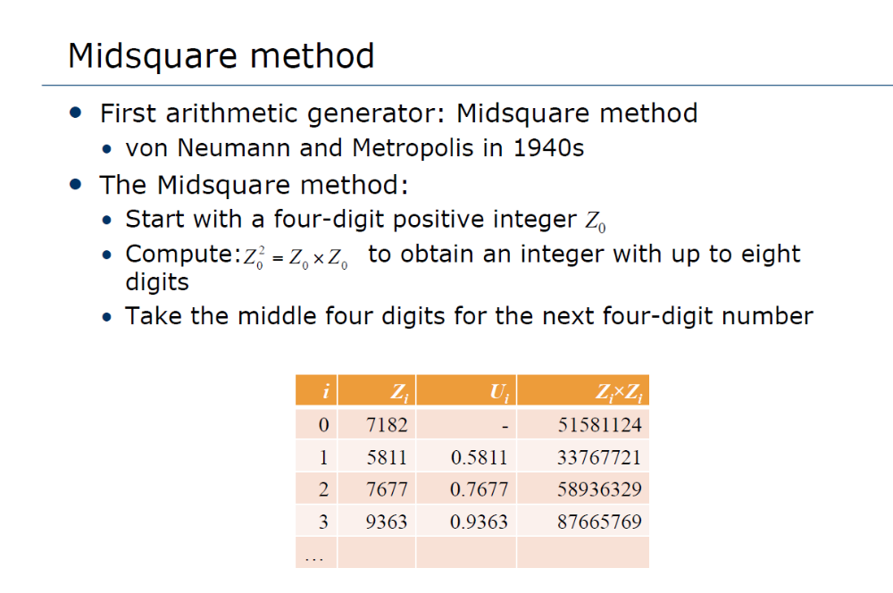

Slide 11
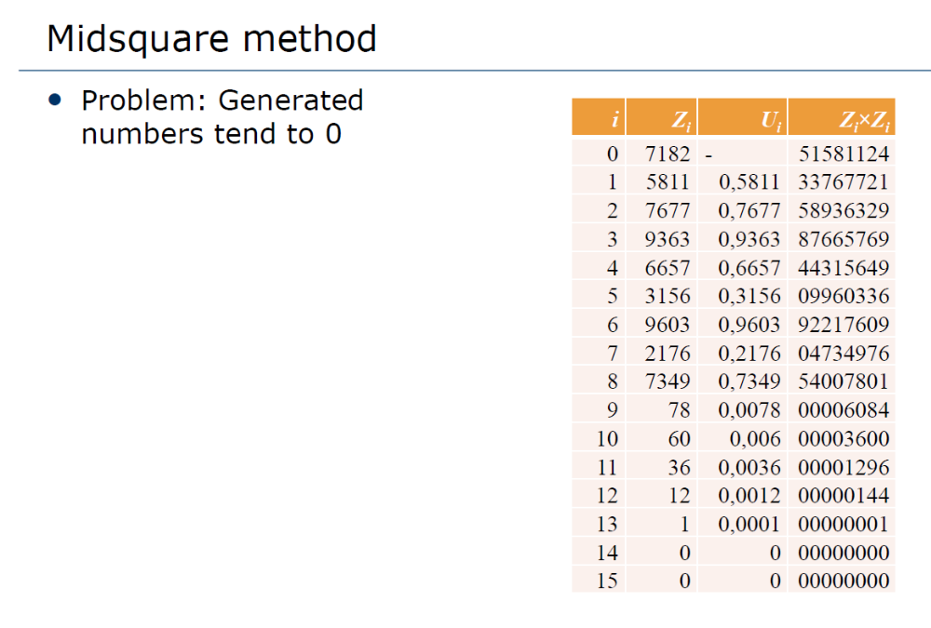

Slide 12
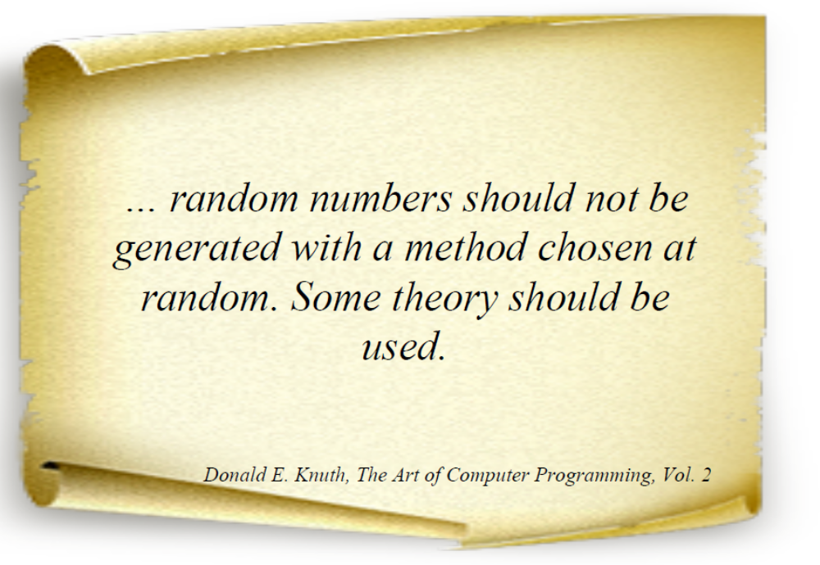

Slide 13
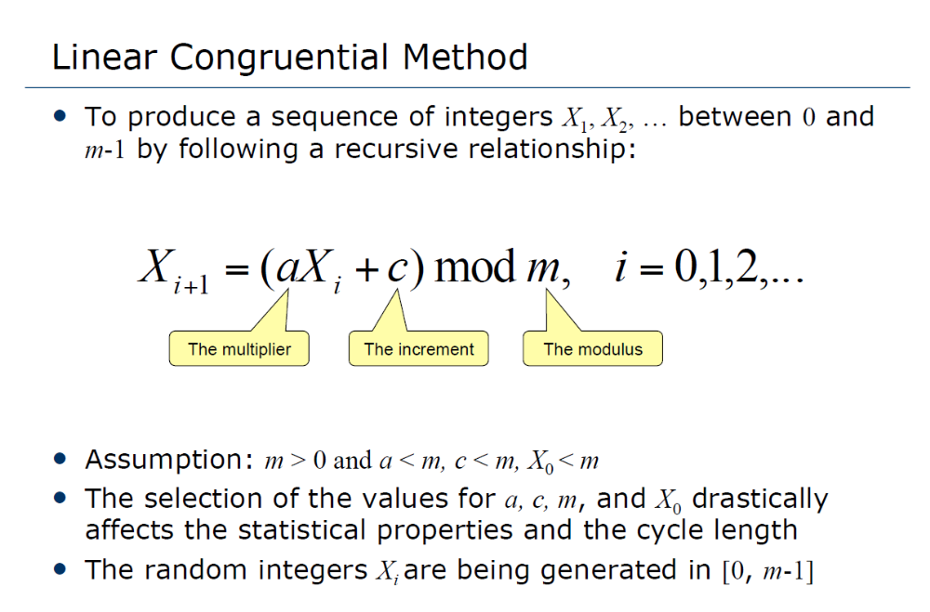

Slide 14
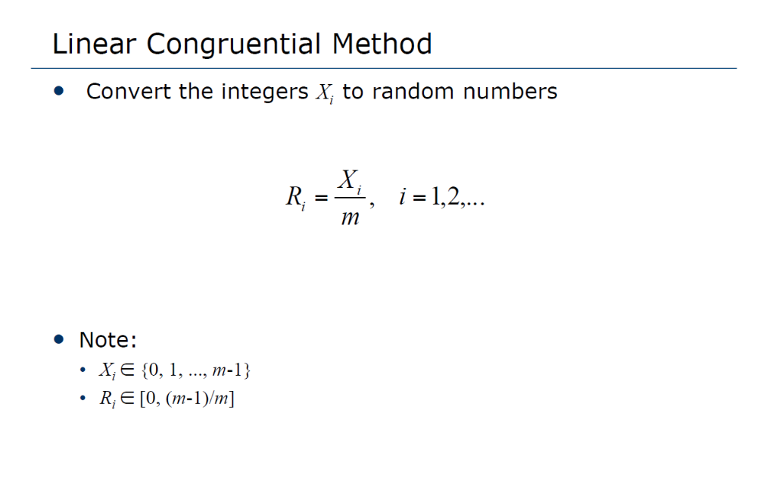

Slide 15
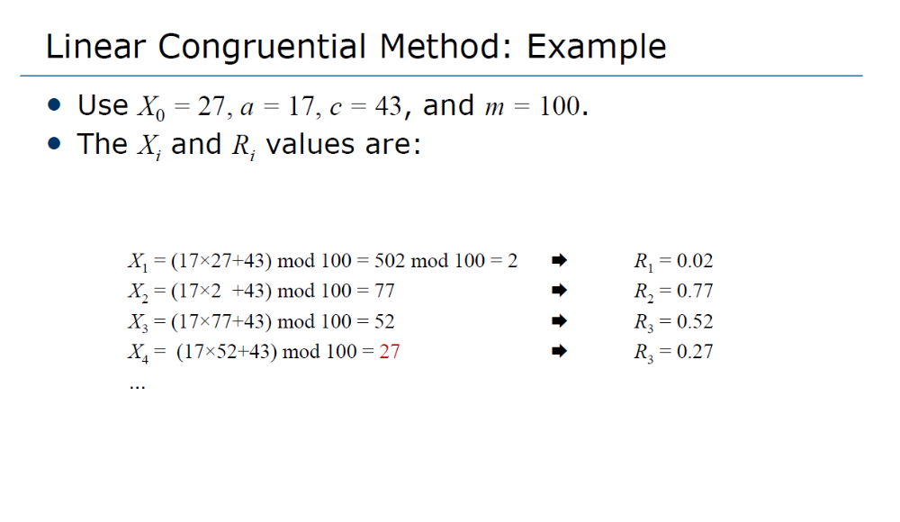

Slide 16
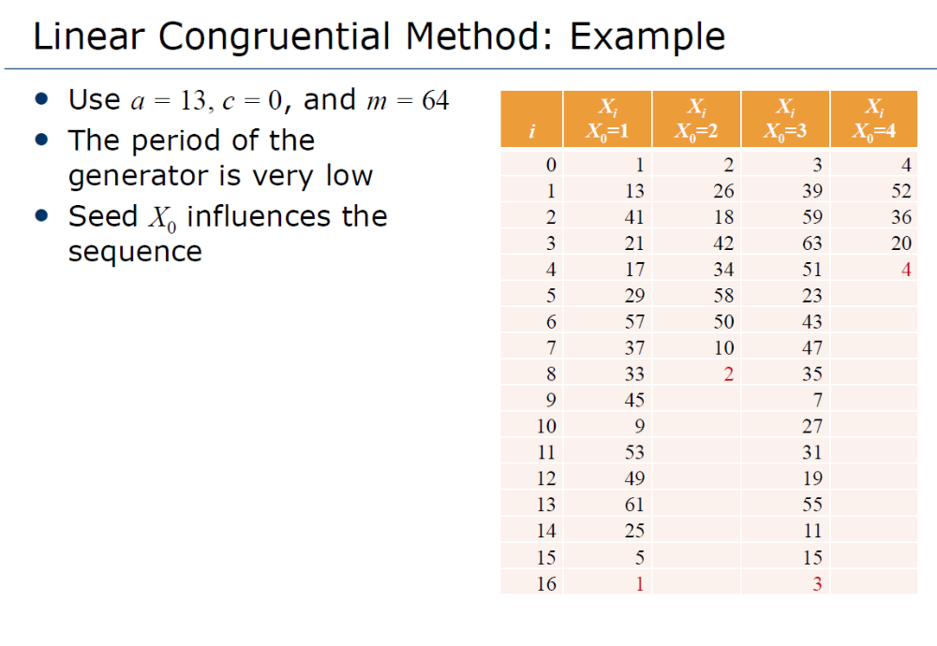

Slide 17
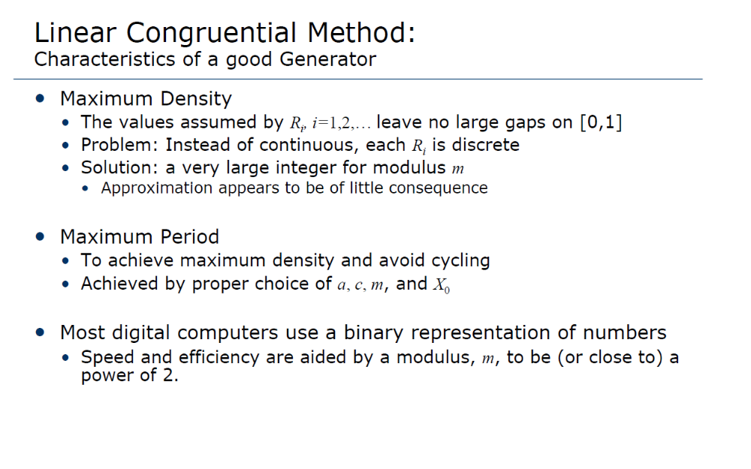

Slide 18
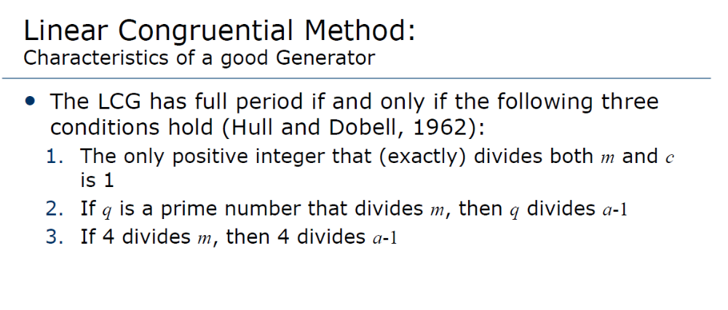

Slide 19
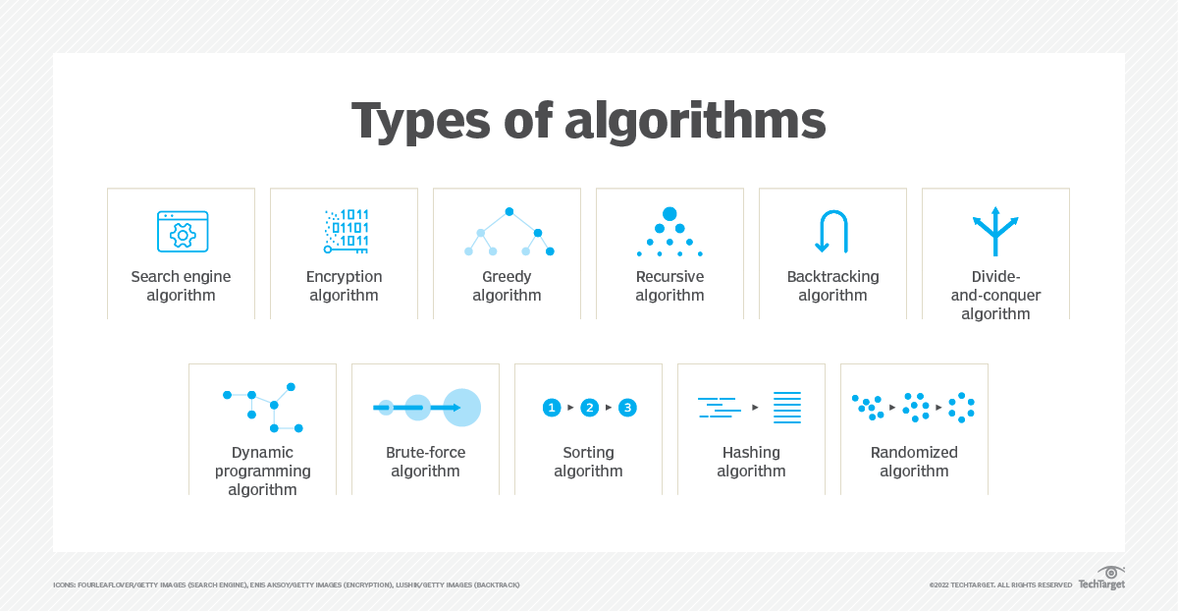

Slide 20
Outline
Properties of Random Numbers
Pseudo-Random Numbers
Generating Random Numbers
  Linear Congruential Method
  Combined Linear Congruential Method

